Slide 1

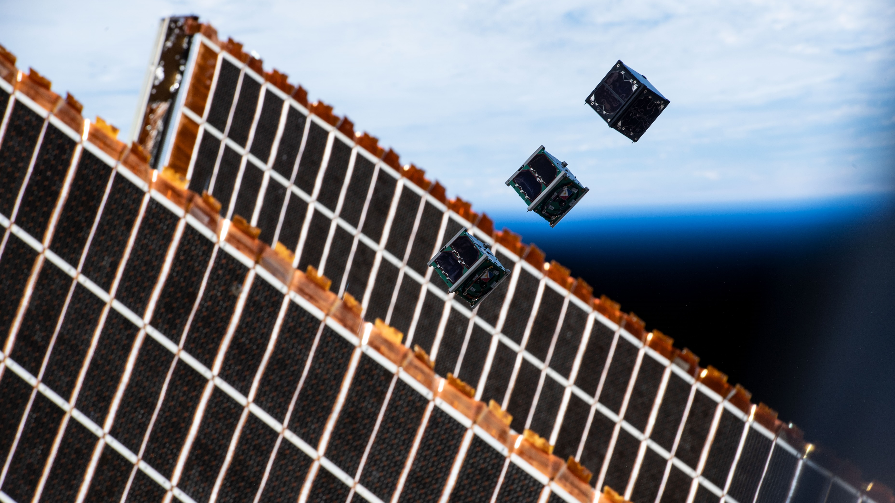



SCHOOL HOLIDAY
PROGRAM SUMMER 2024

Slide 2
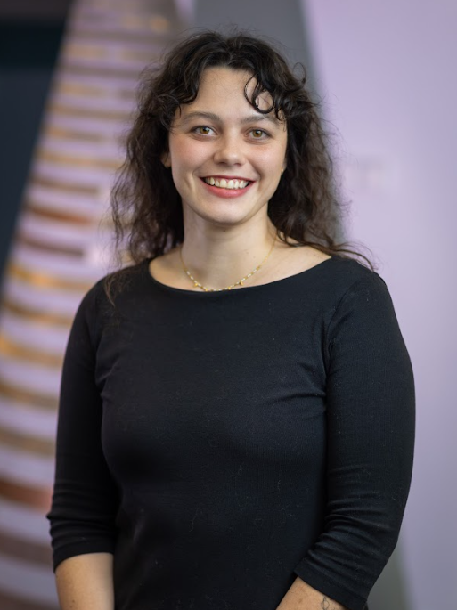
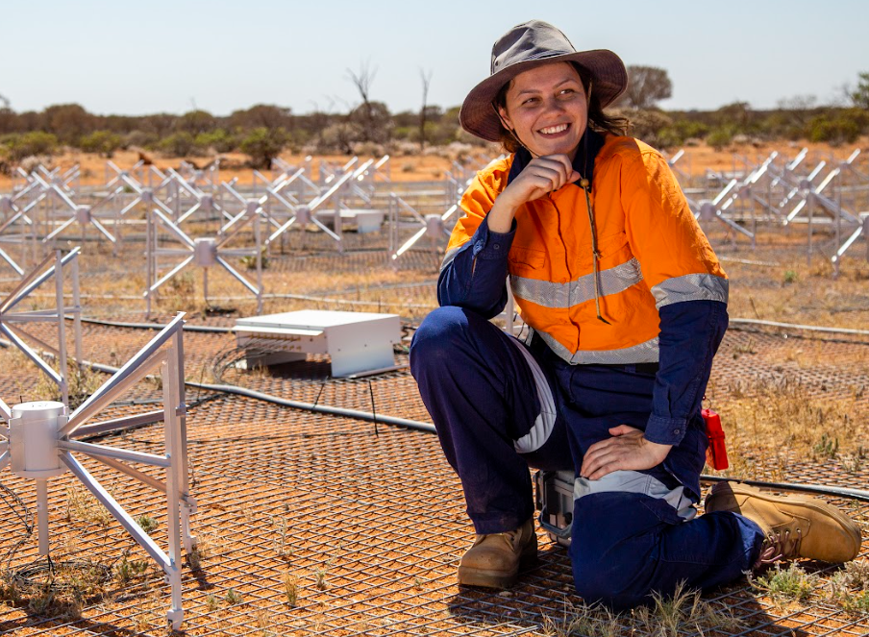
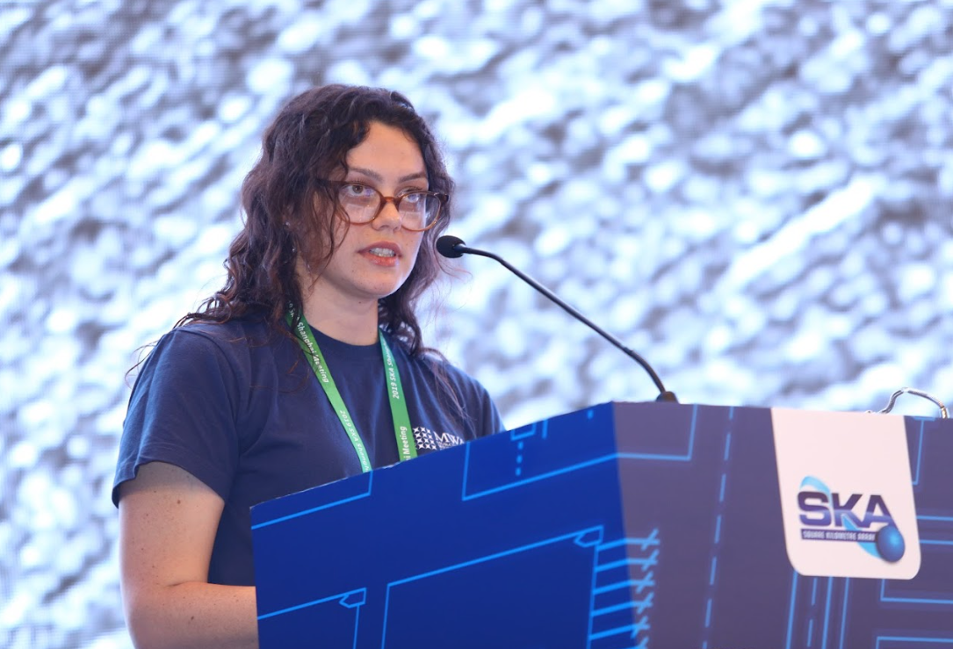
MEET YOUR INSTRUCTORS - MIA
I am the Centre Manager. Pronouns: she/her
I support the operations and missions of the SSTC
I studied electronics engineering and physics at Curtin
I worked on the MWA and SKA radio telescopes
Notes:
Other facts
-geraldton
-ND, lgbtqi+
-artist and writer
-learning the harp
-solar system tattoo

Slide 3

Communicating with Impact
Instructor: Mia
Notes:
So today we’re going to have a short discussion about what it means to communicate your work with impact and then how we can do that with our posters
This is something most researchers don’t learn how to do well, and it is arguably the most important part of research. Because you can be the smartest girl in the world or have a million dollar idea, but if you can't communicate it to other people, then those ideas die with you and no one will know how brilliant you are.
Communicating with impact is also a key skill that’s useful in every job, and also in your everyday life. What do I mean by that?
What’s communicating, what are some ways that we communicate? Talking, writing, texting, emails, messaging, drawing. Some of these might come more naturally to you than others
What’s impact? When we say we want to make an impact, we want to make a big effect, or leave an impression, or get across an idea very strongly
So if we can communicate with impact, we’re able to connect with a person better, and they walk away with a better understanding of what you were saying.

Slide 4
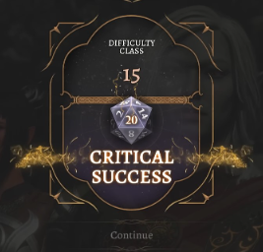
Consider your Audience
Instructor: Mia
Notes:
Now let me give you an example. Let’s say you’re the best speaker in the world. You’re amazing, every word you say is magic to people’s ears. And then one day you’re giving a speech to someone and you realise that they’re deaf, they can’t hear you. Even though you’re the best speaker in the world, do you think your speech is going to make much of an impact on this person? No, you’ll need to find another way to communicate with them. So the biggest thing to remember is that communicating with impact is always about your audience.
I don’t know if any of you have played baldur’s gate or a dice-rolling game, but you might like to think of communicating with impact as improving your charisma stat, which can be helpful in every interaction ☺

Slide 5
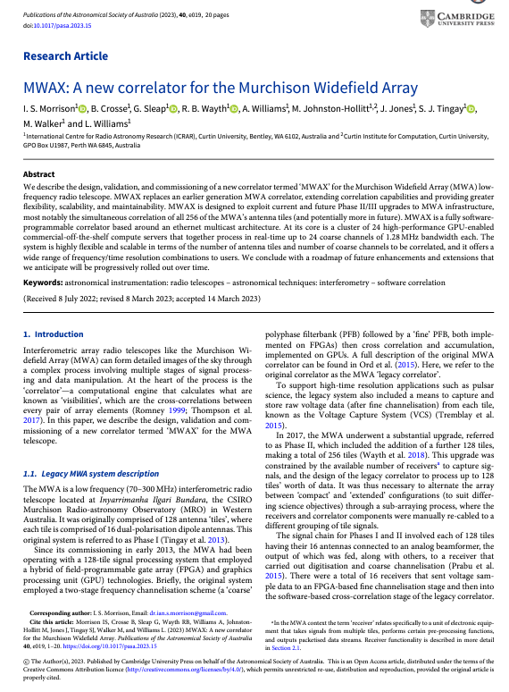
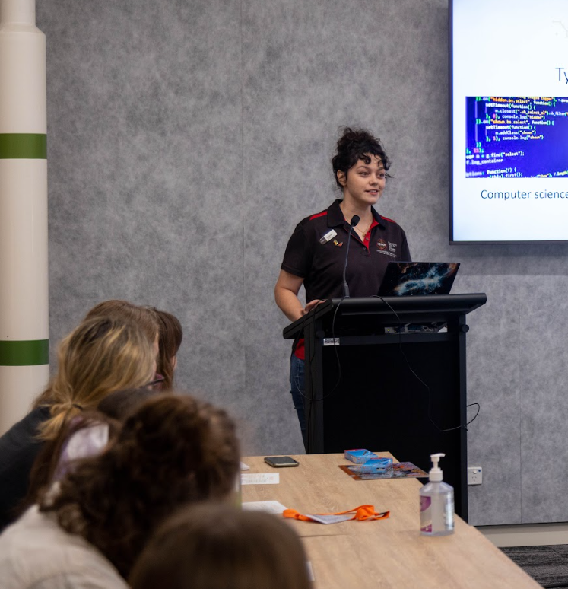
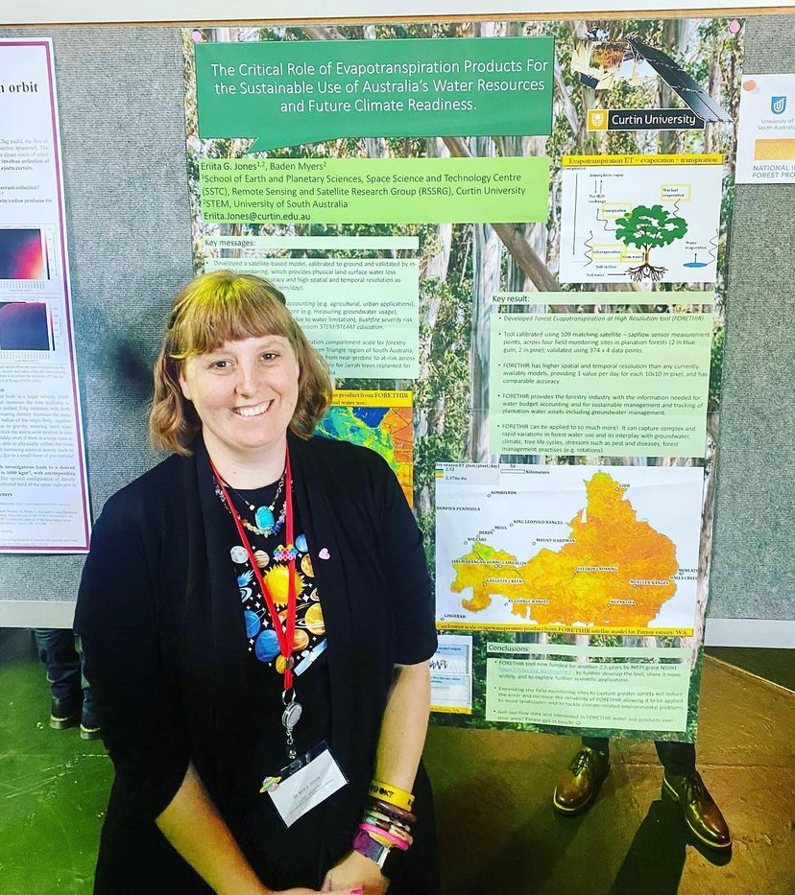
Communicating with impact
PUBLICATIONS
PRESENTATIONS
POSTERS
ENGLISH
DRAMA
ART
Instructor: Mia
Notes:
Having that charisma and storytelling ability and being able to change your communication based on your audience, to have the most impact, that’s a different skillset to what we associate researchers with! (All the hard science subjects.)
but we still make them do it anyway, and some are better than others. The three main research communication methods, the 3 P's: publications, presentations, and posters.
Which subject at school do you think each one is similar to? english (lots of writing), drama (lots of expressing yourself) and art (lots of visuals)
hands up, based on that description, what ones would you would rather do….a publication? a presentation? Or a poster?
Now the cool thing about doing posters is that you can sort of lean into all of these skills a bit, because you’ll need to write your results, and you’ll have the opportunity to talk about what happened as well as do some graphics.

Slide 6

Communicating with impact
CONSIDER YOUR AUDIENCE
Who are they?
What do they already know?
What do you want them to know? (key message)
This Photo by Unknown Author is licensed under CC BY-NC
Instructor: Mia
Notes:
So for everyone here, the poster is your main method of communication, and we’re going to think about how we can we make your poster more impactful. And I want you each to write down or tell me one thing in response to each of these questions as we consider the audience of your posters.
Let’s identify the audience first. so who will be looking at your poster? (your family, the people in other teams, and your instructors)
What do they know about your project already? Do they already know a bit about rockets? About your payload? About electronics?
(This is important because you’ve been here for a week now, you’ve been learning a lot of things, so you might fall victim to something researchers get which is called ‘the curse of knowledge.’ teachers do this do sometimes, its when they assume you know something, and you’ve never heard of it before! So let’s assume knowledge.)
So last question is, what do you want them to know? If your friend walks away from your poster, what’s the one thing you want them to know about it? Was it how you did some 3d printing, or designed the payload, or maybe its something that went wrong. This is your key message, and Ill give you a minute to think about that.
Ok so looking at this slide, what do you think my key message is? What’s the one thing I want you to remember about how to communicate with impact? (audience)
(It can be difficult when you need to appeal to different groups at once, who have a range of understanding. My advice is to shoot for the middle if you can, or the lower group. The ones with a greater knowledge will ask more detailed questions and you can talk to them individually or separately while still making sure the majority of people you present to understand.)

Slide 7
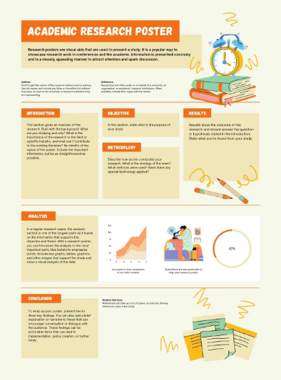
Communicating with impact
YOUR POSTER
Does it highlight your key message?
Does it have all the elements:
Introduction, objective, method, results, analysis, conclusion, people involved
Instructor: Mia
Notes:
So let’s consider your own posters now, maybe you’re already finished with them or maybe you’re just starting. Does your poster highlight your key message? In English we used to call this a ‘thesis statement’.
But we can’t just have a huge blank piece of paper with one thing written on it and call that a research poster. It needs all the juicy context!
Here’s some Common parts of a research poster. Similar to a lab report if you've done one of those at school. There’s lots of templates you can use for canva or powerpoint, but it’s always good to customise it so we can maximise impact!

Slide 8
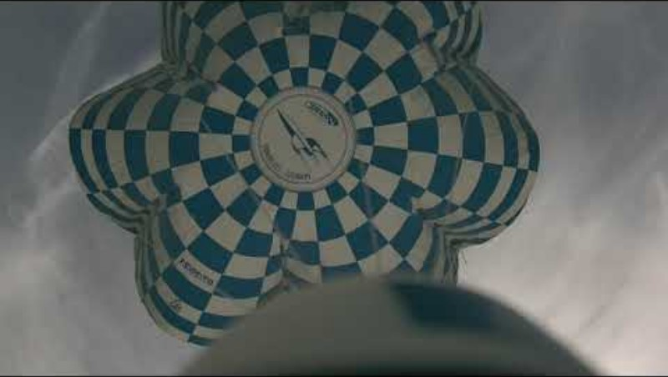
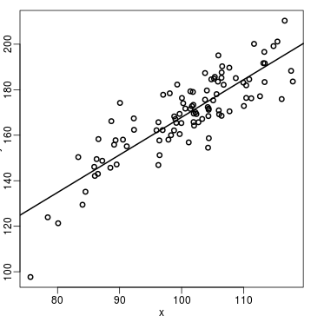
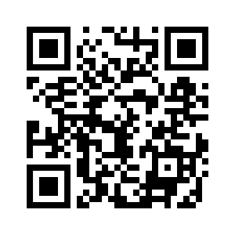
Communicating with impact
IS YOUR POSTER…
Easy to read? Size? Font? Colour?
Too wordy? Not wordy enough?
Using good images?
Engaging?
https://www.youtube.com/watch?v=msETb6_7OMk&t=61s
Instructor: Mia
Notes:
So how else can we maximise impact with our posters. You might’ve been working on your poster for ages, staring at it until it’s boring and you know every detail of it, so it’s time to consider your audience again, and think about someone who is looking at it for the very first time. What do they see.
Is it accessible? By that I mean, is your writing big enough, and are you using a font that's easy to read? Think about colour combinations too, red and green aren’t easy to distinguish for a lot of people
Is there too much text? Is your language clear? Have you expanded any acronyms, and explained concepts that your audience might not know?
A picture can be worth a thousand words, but they need to be there for a reason. Does anyone want to tell me something about this plot that’s bad? (No axis labels, tiny writing, no legend, no units, too small, no credit)
Is your poster engaging to look at? Is there something that’s easier to explain with a link to something on the internet, or a video? I’ve put one here, but for a poster it’s hard to have videos – what’s the better way of displaying it, do you think? This URL, or the QR code?

Slide 9
Communicating with impact
FINALLY…
What’s something that went wrong?
Practice and ask for feedback
Role models
TO COMMUNICATE WITH IMPACT…
Who do you consider? Your [ ? ]
Observation
Hypothesis
Experiment
Scientific
method
audience!
Instructor: Mia
Notes:
So one of the last things I want to talk about is how impactful it can be when things don’t turn out the way you wanted them to. It’s easier to relate to people who mess up, because we mess up. We’re not perfect, and things don’t go right all the time. One of the most powerful presentations I went to and remember was how everything went wrong for this poor researcher. And it was great because they learned a lot from all these failures. failure and learning is built into the scientific method. Some of the world’s greatest discoveries were built on top of things that went wrong the first time.
so we encourage you as budding researchers to think about and tell people about the things that went wrong, the things you’d like to investigate more or do better next time. everyone try and name one thing that you wish went differently during this program. It can be big or small. You might want to find a spot for it on your poster if it isn’t there already.
Practice communicating !! For your poster this might mean making drafts and getting feedback from your group, and its even better if you can get feedback from someone who knows absolutely nothing about the topic, maybe a friend or parent. This can help you prepare to talk about it with others, anticipate what sort of questions people will ask, or you might want to make some changes to your poster based on what they say.
The last one is to look at how other people communicate, and see if you can learn from them. This is called having role models. It doesn’t have to be someone you’ve never met like a TED talker, maybe you have a favourite teacher at school, someone who is well versed in English or drama or art. Think about them now, and what you like about their class. Maybe they make the topic more fun, or easy to understand. That ability to connect with you means they are communicating with impact, so they are good people to learn from and have as role models.
So that wraps up my intensive class on communicating with impact. Remember, when in doubt, who should you consider? (your audience!)
(All of these things apply for publications and presentations too. For example, I am giving you a presentation. So I have had to think about what you already know about communicating, what you might have studied at school and how I can link it to that, I’ve thought about how we’re going to have food soon so people won’t want to pay attention so what are ways to keep you engaged. So how did I do?)

Slide 10
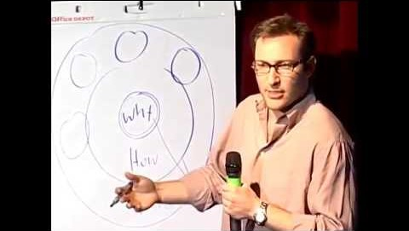
Communicating with impact
MEG'S TAKE – THE VALUE OF PASSION & AUTHENTICITY WHEN SHARING YOUR WORK:
“START WITH WHY”
Instructor: Meg
Notes:
I was one of the weird kids. So over the years I started to think that I was “too much” and needed to tone down my personality or voice. But everyone has value. Everyone has something that they’re good at and that they bring to the table. And when you find that own it. It is your superpower. I think mine is curiosity and infectious enthusiasm for the things I discover – if I’m really excited about something I’m pretty good at getting other people to get excited along with me. Have a think about what yours might be. Don’t lose it, even when people roll their eyes at you. Nurture it. This is your authentic voice.
When I think about the times I’ve been most inspired by a speech or presentation, or simply a conversation – the person communicating would be speaking in their own authentic voice – and in that voice talking about their passion for what they did, why they did it, and why they were inspired to do the work that they do.
The Binar Space Program and the SSTC are wonderful examples of this – every person you’ve heard from in the last 2 weeks exemplifies this – yes, we are “building 1U cube satellites for low earth orbit” (which admittedly is pretty cool), but why are we doing this? We are all working together to “Put Space in the hands of WA” and “revolutionise access to space” by “drastically lowering the barriers” of cost and time. I am so incredibly proud to wear the BinarX and Binar shirts and get to spend my days with these incredible humans you’ve met during the program, as well as being able to be a part of connecting that work to the future of the WA space and planetary science sectors, which I hope will be at least a few of you!

